Slide 1

Topic: Ruling Reign Of Uber Rohan Yadav(c0773871) Swapnil Sevak(c0777195) Shahrukh Padaniya(c0769542)
Instructor: Prof. Sisay Shega

Slide 2
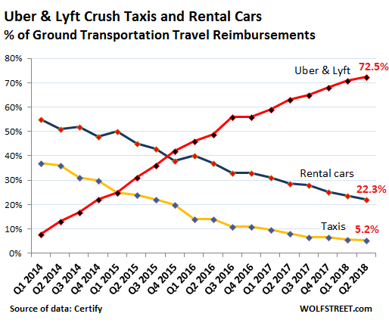
Uber is more popular over their competitors in cab industry because of following reasons: -

Slide 3
Wide Customer Base
40 million active monthly rides.
Over five million rides per day worldwide.
Around 50,000 new drivers joins Uber every month.
Uber operates in over 60 countries and 400 cities.

Slide 4
Fares and Availability
Lower fares compared to their rivals.
During pick hours uber costs minimal than any other cab services.
It provides cheapest rate in rideshare option.

Slide 5

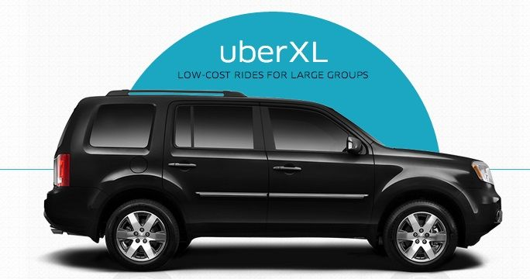
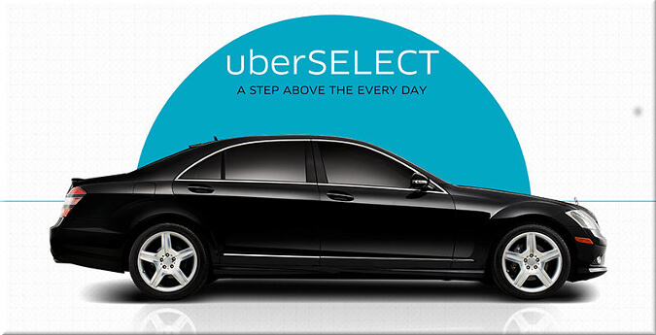
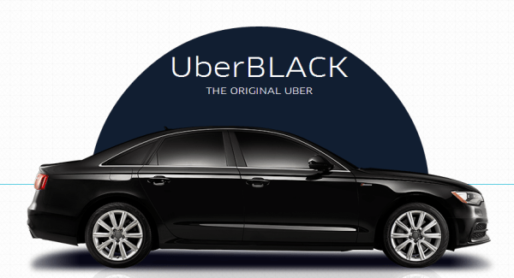
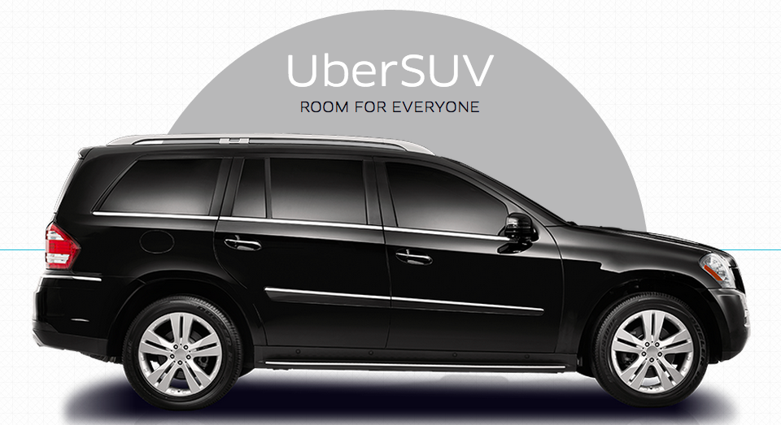
Broad variety of cabs to select
Choice is a beautiful thing!
uber.com

Slide 6
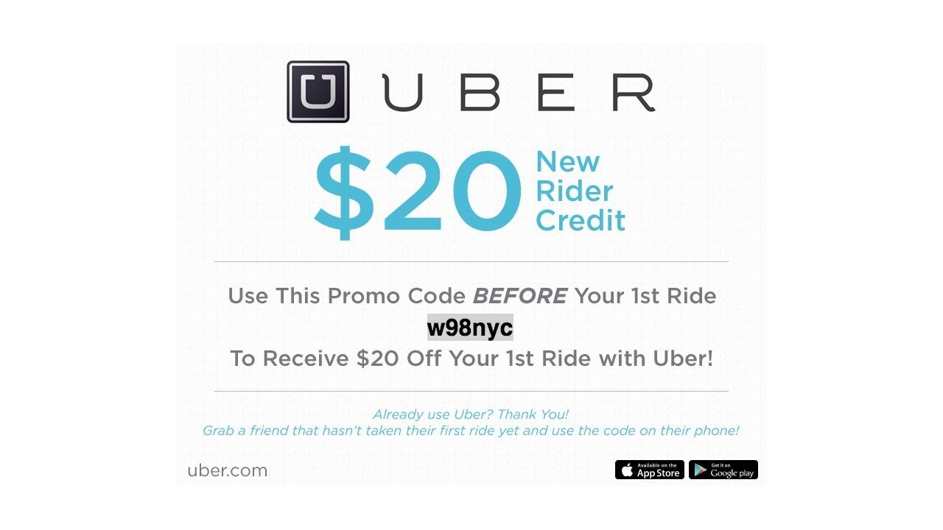
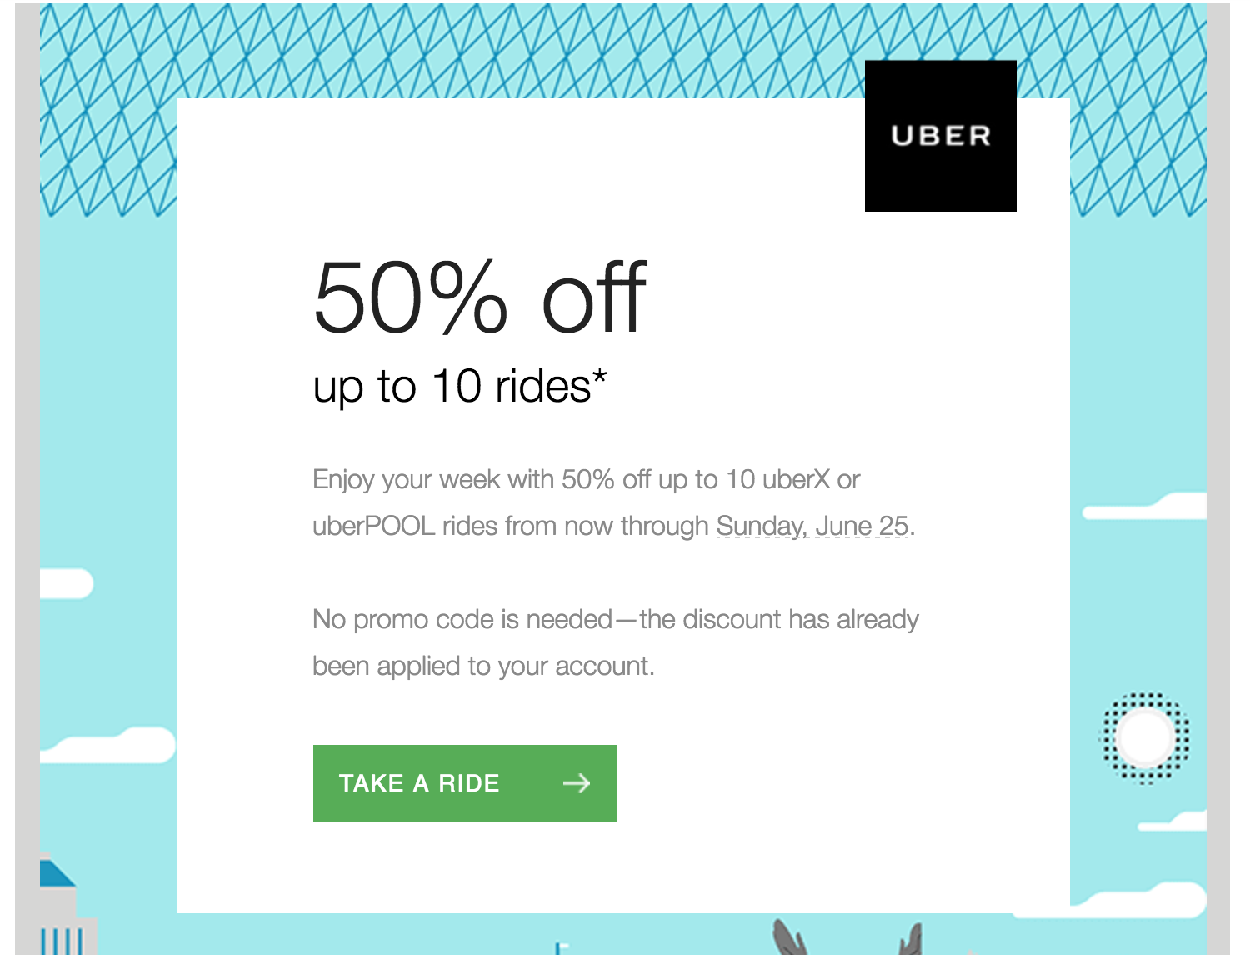

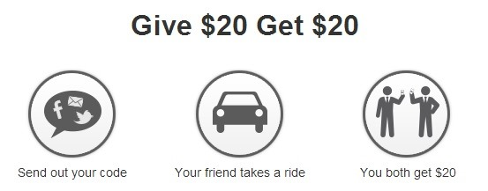
Marketing Strategies
Promotional offers and discounts

Slide 7
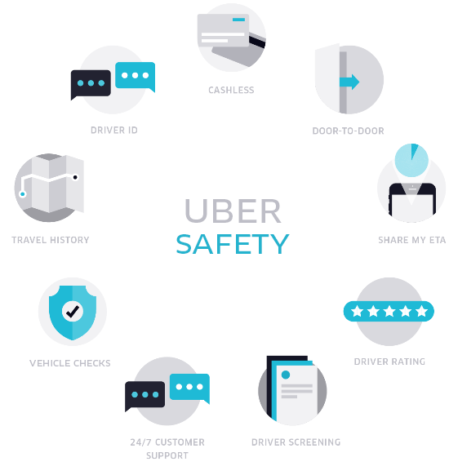
Services and Security
Reliable mobile software
Robust payment infrastructure
Simplicity of the Uber application
All drivers are background checked before their first trip

Slide 8
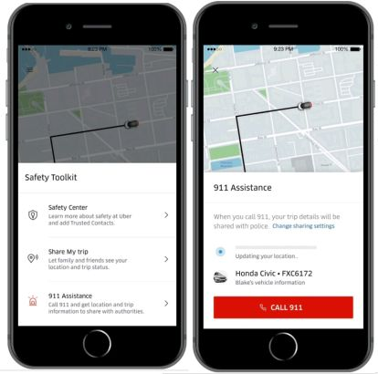
Safety Features
Emergency button
AI that can detect crashes
Auto insurance on every trip
24 X 7 Uber support
Record rides (in app audio recording)

Slide 9
References
Zokhareuski, A. (December 10,2019). Uber driver requirements. Retrieved from https://driving-tests.org/beginner-drivers/become-an-uber-driver-things-to-know/
Picchi, A. (June 10,2019). Uber vs. Taxi: Which Is Cheaper. Retrieved from https://www.consumerreports.org/personal-finance/uber-vs-taxi-which-is-cheaper/
Markman, J. (January 14,2020). Uber finally focuses on driving toward profits. Retrieved from https://www.forbes.com/sites/jonmarkman/2020/01/14/uber-finally-focuses-on-driving-toward-profits/
Cohan, P. (April 13,2019). Why uber lacks a sustainable competitive advantage. Retrieved from https://www.forbes.com/sites/petercohan/2019/04/13/why-uber-lacks-a-sustainable-competitive-advantage/

Slide 10


THANK YOU

